Slide 1
AIML ST1511
Unsupervised Learning
Managing and Retaining
·Employees·
Name: Soh Hong Yu
Admin No: P2100775
Class: DAAA/FT/2A/01

Slide 2
· Background Information ·
In big companies, many employees leave and go. As a HR manager, you want to understand why these employees are leaving the company. With this information, what can we do to improve to keep the existing employees. The following are some likely reasons why employees leave the company.
Potential Reasons for leaving the company
1. Attrition due to retirement
2. Voluntary attrition
3. Involuntary attrition
4. Internal attrition
5. Demographic-specific attrition

Slide 3
· TABLE OF CONTENTS ·
01
02
03
04
DATA EXPLORATION
DATA PREPARATION
Exploratory Data Analysis
Dimensionality Reduction
MODEL SELECTION
CLUSTER EVALUATION
Best clustering model
Evaluating Clusters

Slide 4
01
· DATA EXPLORATION ·
Exploratory Data Analysis

Slide 5
· Data Information ·
Name | Data Type | Description
Age | Numerical | Employee age
Gender | Categorical | Employee gender
BusinessTravel | Categorical | Business travel frequency for the employee
Job Function | Categorical | Department of the employee
Distance Between Company and Home | Numerical | Distance between company and home
Education | Numerical | Education qualification of employee (1 is lowest, 5 is highest)
Job Satisfaction | Numerical | Employee's job satisfaction (1 is lowest, 4 is highest)
MaritalStatus | Categorical | Marital status of employee
Salary ($) | Numerical | Employee's salary
Performance Rating | Numerical | Employee's performance rating in the company (1 is lowest, 4 is highest)
Work Life Balance | Numerical | Work life balance rating (1 is worst, 4 is best)
Length of Service | Numerical | How many years the employee works for the company (Years)
Resign Status | Categorical | Is the employee still with the company

Slide 6
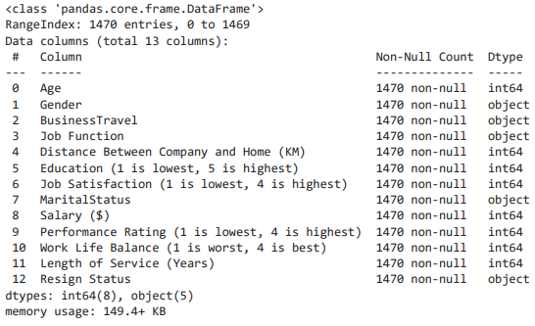
· Data Information ·
Using pd.info(), we can make some observations.
The shape of dataset is (1470, 13)
There are no missing values in the dataset

Slide 7
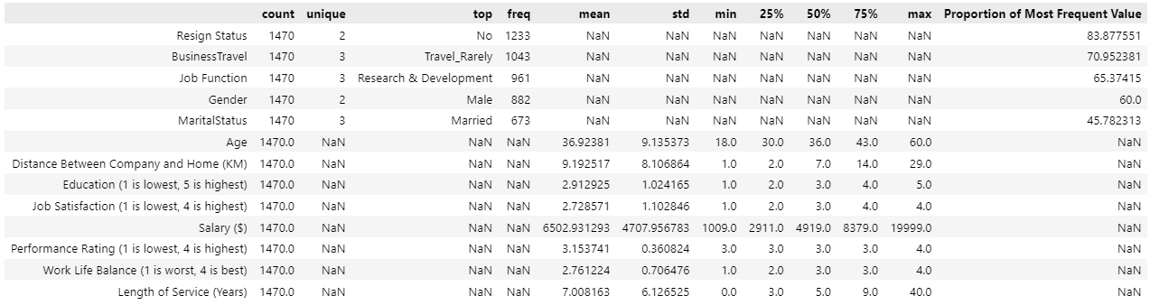
· Data Information ·
Using the .describe(include=”all”) function, we are able to use it to find the proportion of values.
From looking at the most frequent value of each column, we note that:
Resign Status is negatively skewed

Slide 8
· Pandas Profiling ·
Pandas Profiling is a convenient tool to quickly explore datasets. We will be using it to get some summaries and will be using numpy and pandas functions to replicate the points.
Summary:
1. Salary ($) is correlated with Length of Service (Years) = 0.5142848257331957
2. Age is correlated with Length of Service (Years) = 0.3113087697450989
3. Salary ($) is correlated with Age = 0.4978545669265801
4. Number of zeros in Length of Service (Years): 44
Percentage of dataset: 2.9931972789115644%

Slide 9
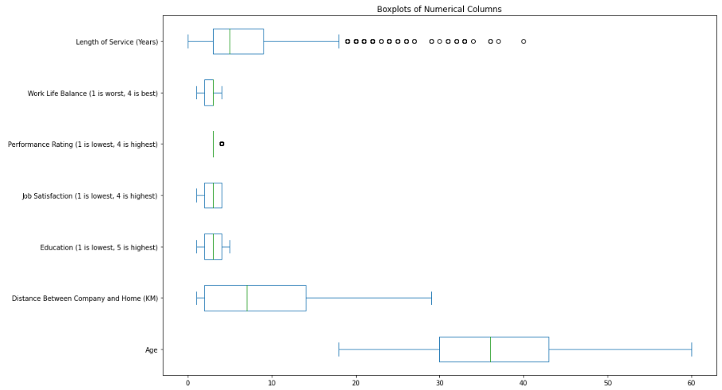
· Univariate Analysis ·

Slide 10
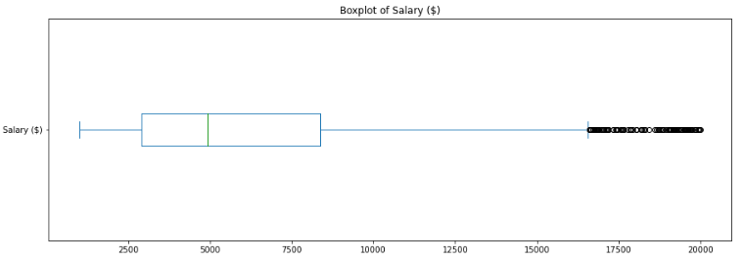
· Univariate Analysis ·
We can see that the data is skewed and there are also outliers in the boxplots shown. This suggest that we will need to standardise the data

Slide 11
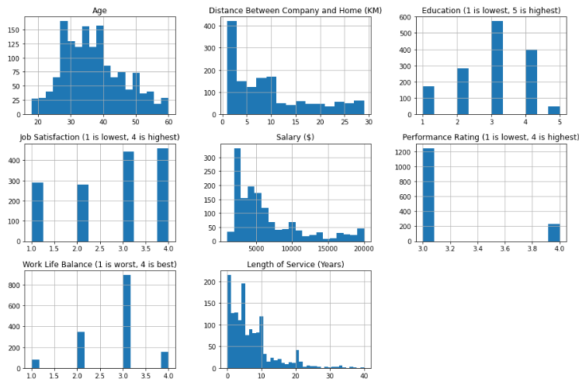
· Univariate Analysis ·

Slide 12
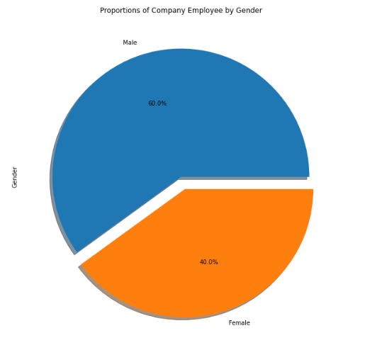
· Univariate Analysis ·
Summary
Overall, there are more male employee compare to female employee.
The difference in margin is not so significant to consider the class to be imbalanced

Slide 13
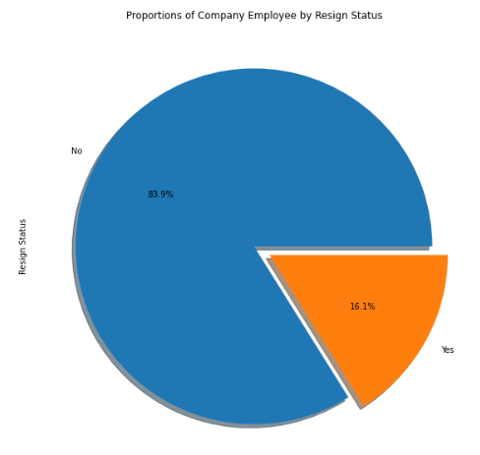
· Univariate Analysis ·
Summary
Overall, there is a minority in people who resign and not stay in the job.
84% of the employees in the dataset have not left the company.

Slide 14
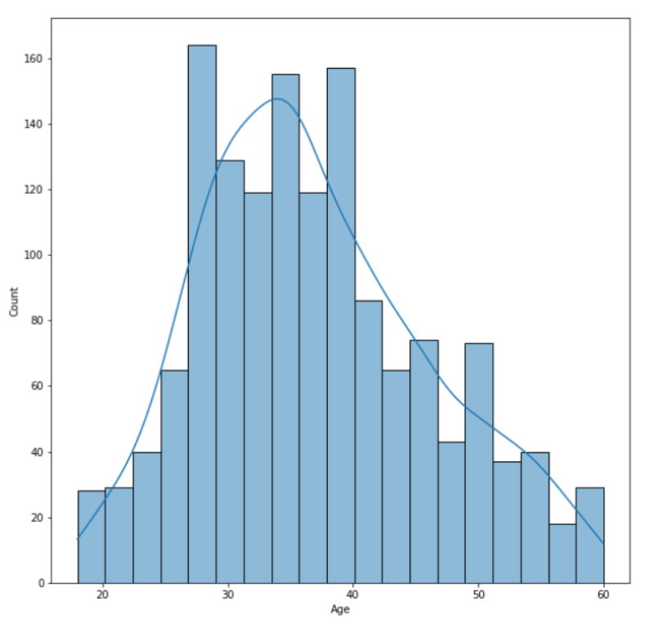
· Univariate Analysis ·
Summary
Most employees are in their 30s with 35 year old's having the highest count and lowest are people at around the age 60 or less than 20.

Slide 15
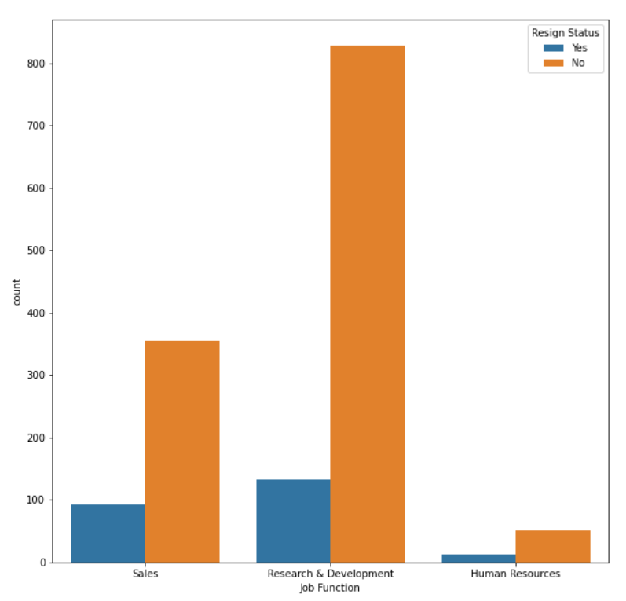
· Bivariate Analysis ·
Summary
Most resignation are from the research & development department only for sales department to come second by a small margin. HUman resources has the least number of resignation. But we need to keep in mind that R&D has a lot more employees than sales and HR.
If we considered percentage of resignation per department, we would see that the HR department has most resignation.

Slide 16
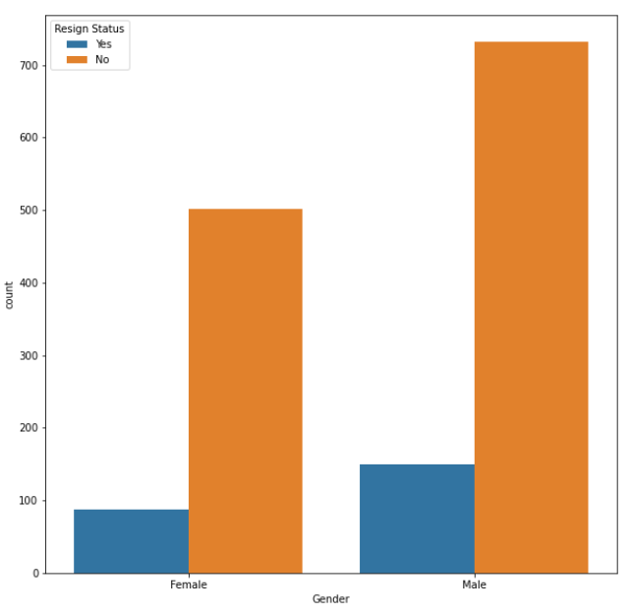
· Bivariate Analysis ·
Summary
There are more males in the organisation than females, so resignation are higher but slightly. Therefore, gender is not a significant a factor behind resignation status.

Slide 17
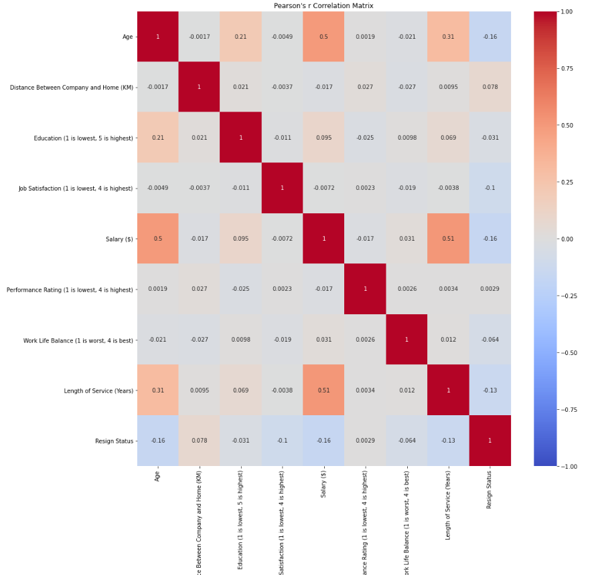
· Bivariate Analysis ·
To confirm any correlation between the different features, we will make use of Pearson’s r correlation coefficient.
Note: However, the Pearson's r Correlation is unable to calculate the correlation between qualitative data like Job Function.
Most variables have little to no linear correlation between variables. There is no pattern in the scatterplot between variables.
Age vs Salary; 0.5 r value indicates there is a moderate positive correlation between age and salary. A "cone" shape pattern that can be seen from the scatterplot which indicates that there is a larger variation of salary when you are older.
Length of Service vs Salary; 0.51 r value indicates that there is a moderate positive correlation between length of service and salary. A clear cluster in the length of service vs salary where salary is at a range from around $3000 to $7500 and length of service is at range from 5 to 10 years.
Age vs Length of Service; 0.31 r value indicates that there is a weak positive correlation between age and length of service. As the older you are, one is more likely to serve in the company longer.

Slide 18
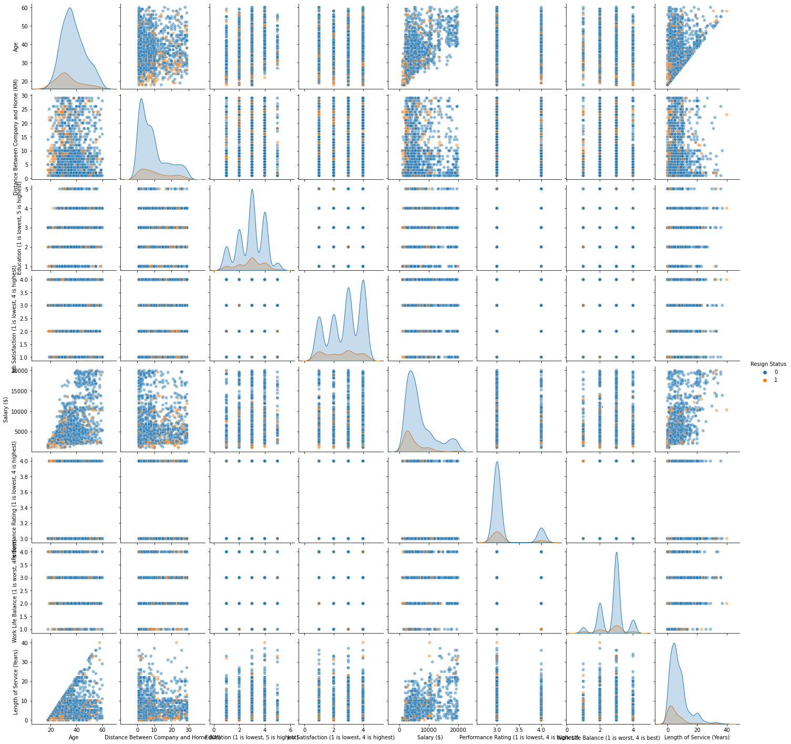
· Bivariate Analysis ·
To look through the different plots to find obvious clusters
There are no clear clusters that formed which means some feature selection and engineering will need to be done
Certain variables as mentioned in the correlation section has a slight linear relationship. One example is Age vs Length of Service

Slide 19
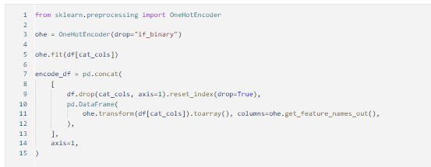
· Data Preparation ·
As the our dataset still contains categorical data which is hard for some of sklearn's model to train on, we have to encode the data using one of the encoders.
pd.get_dummies()
One Hot Encoder
Label Encoder
Ordinal Encoder
As most of the categorical columns
have multiple values, we will use one
hot encoder and drop if it is binary to
remove additional columns like
gender (Male and Female) which can
be identified as if you are not male then you are female.

Slide 20
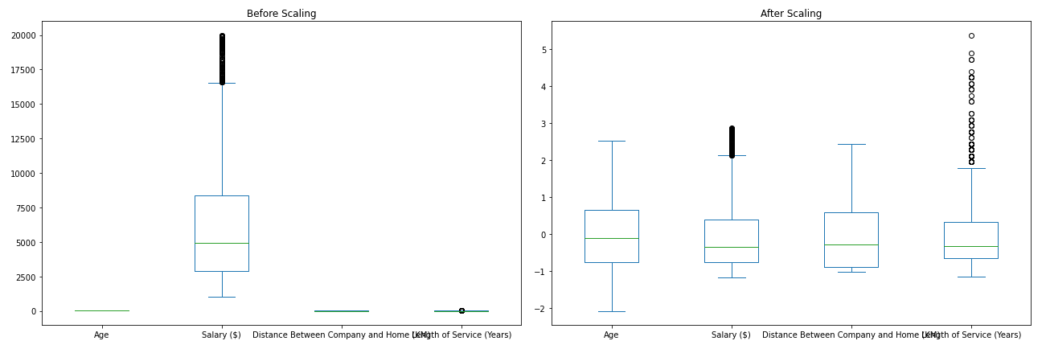
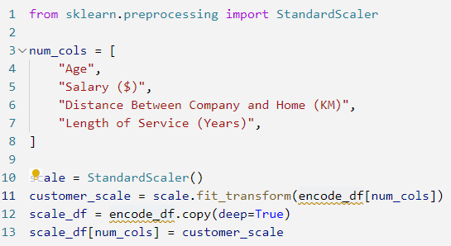
· Standardization ·
Typical Clustering Models are distance based algorithm, in order to measure similarities and form clusters using distance metrics. By standardization, there would be no statistical bias between features within the learning algorithm. Therefore, standardization is required before building a clustering model.
In this case, I would be using Z-Score Standardization to perform feature scaling. This is to ensure that all of the features would have the mean and variance, following N(0, 1).

Slide 21
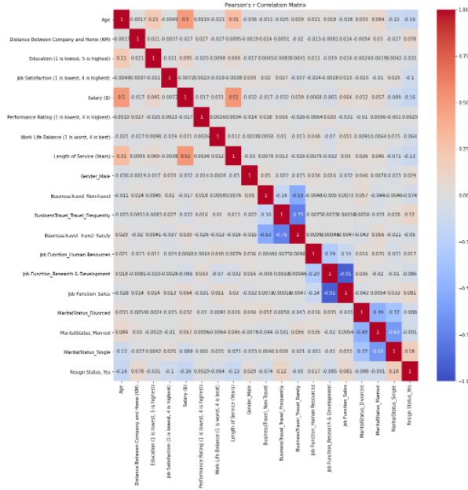
· Pearson’s R Correlation ·
We look at the different correlation for the new encoded and scaled dataframe
There is no clear correlation between variables except those categorical data which we have hot encoded.
Job Function Research & Development has a high negative correlation between Job Function Sales as 1 person can only be working at 1 department which therefore caused the strong correlation.

Slide 22
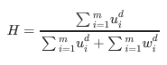
· Clustering Tendency ·
Before we continue to cluster, we want to know if the dataset can be clustered well so that we can interpret the silhouette scores. We will be using Hopkins Statistics.
Hopkins Statistics is a hypothesis test where H₀ is the data is uniformly randomly distributed.
H₀ : Data is uniformly randomly distributed
H₁ : Data is not uniformly randomly distributed
A value close to 1 tends to indicate the data is highly clustered, random data will tend to result in values around 0.5, and uniformly distributed data will tend to result in values close to 0.
Score: 0.6430111815128152
We note that this test is run on all variables this shows the data has a low tendency to cluster

Slide 23
· Data Preparation ·
Before a cluster, we need to prepare the data for mutation. Even tho our Hopkins is > 0.5 and it has a lower tendency to cluster. However, the actual data is also close to 0.5 which means the clusters are also randomly displaced. The issue comes when hot encoding, additional columns are created which makes dimension reduction important. There are many methods to reduce the dimension of a dataset.
1. PCA
2. T-SNE
3. Gower Distance
4. UMAP
We will be using some of these methods to help us reduce the dataset.

Slide 24
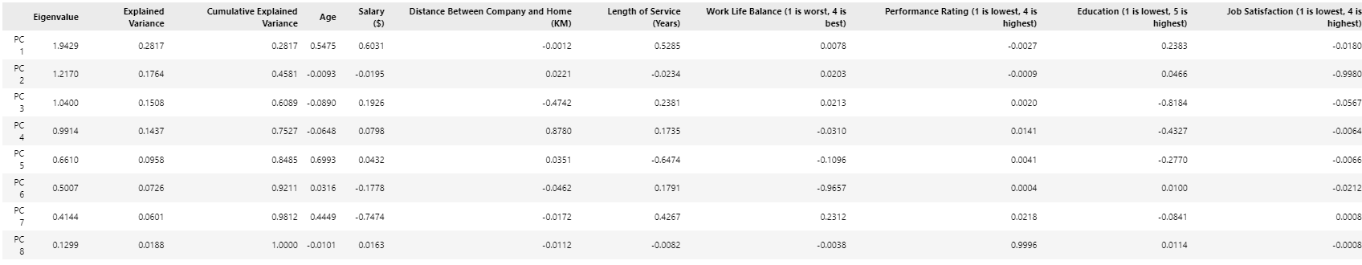
· PCA ·
Principal component analysis, or PCA, is a statistical procedure that allows you to summarize the information content in large data tables by means of a smaller set of “summary indices” that can be more easily visualized and analysed. In summary it reduces the number of variables in the dataset at expense of accuracy. However with a smaller dataset, more data can be analysed faster.
However, a constraint is that all data we use PCA to must be quantitative. Even though we have hot encoded the data and it is now quantitative, applying PCA to this variables will make it difficult to reduce the data as it is completely useless.

Slide 25
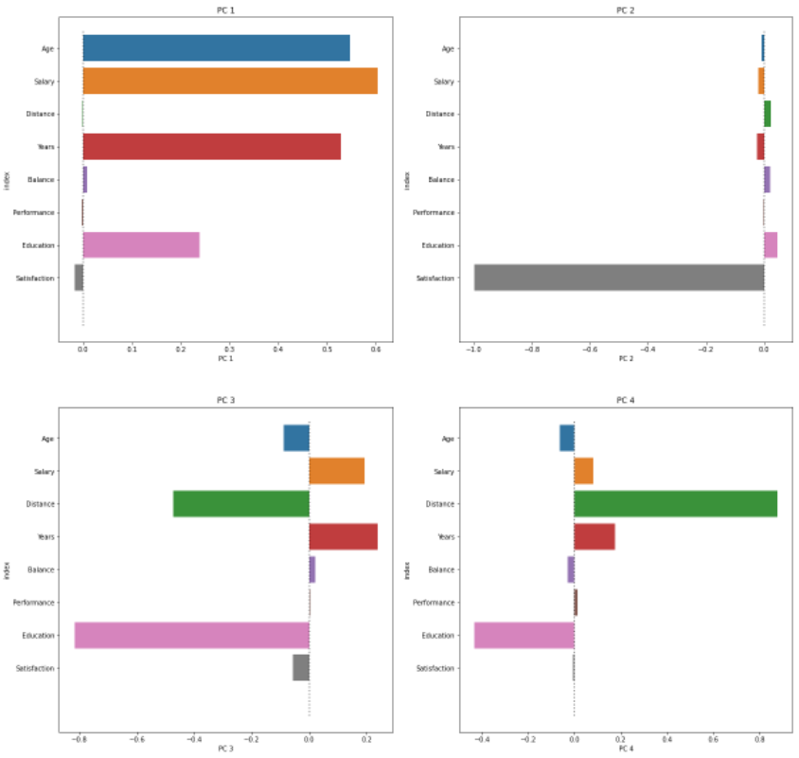
· PCA ·
A general rule of thumb when doing PCA is to use the cumulative explained variance of 75%. Thus we select PC1 to PC4
1. In PC1 seems to represent employee information. Age, Salary ($), Length of Service (Years), Education have high positive loading while the others have negligible or low negative loading.
2. In PC2 seems to represent employee job satisfaction as Job Satisfaction has a high negative loading while the others have negligible or low positive loading.

Slide 26
· PCA ·
3. In PC3 seems to represent employee job involvement. Age, Distance between company and home, Education, Job Satisfaction have high negative loading. It also show Salary and Length of Service a high positive loading
4. In PC4 seems to represent employee experience in company. Education, Age is not important in the employee's experience that is why it has a high negative loading. Salary, Distance, Years are involved in the experience in company as the longer you work, the more salary one will get and distance travelling to work is an experience that all employee will experience

Slide 27
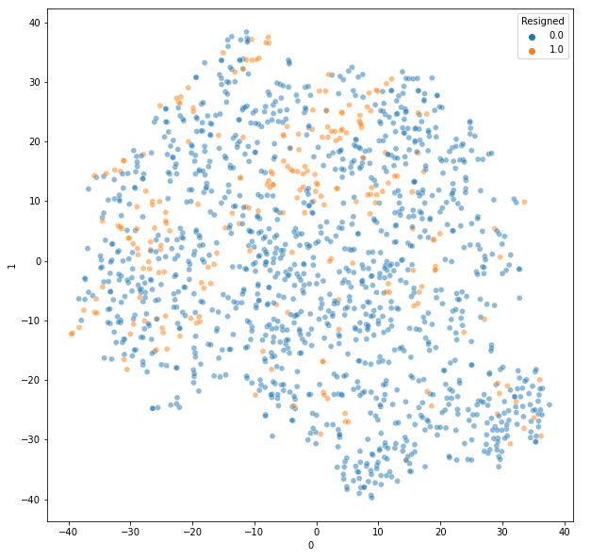
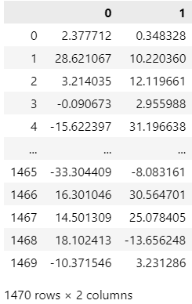
· t-SNE ·
t-Distributed Stochastic Neighbour Embedding also known as t-SNE is used to help us visualise our high dimensionality dataset into two dimensions.
By plotting the t-SNE, we can
see that there is no clear
clustering of resignation
which means pure tSNE does
not form insightful clusters
to find out why employees
are leaving the job.

Slide 28
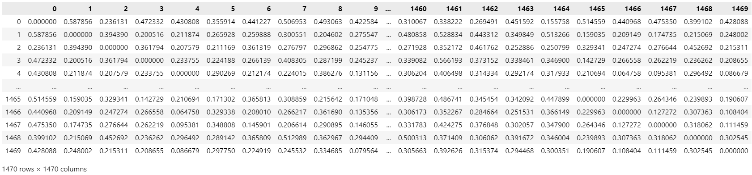
· Gower Distance ·
The Gower distance is a metric that measures the dissimilarity of two items with mixed numeric and non-numeric data. Gower distance is also called Gower dissimilarity. One possible use of Gower distance is with k-means clustering with mixed data because k-means needs the numeric distance between data items.
To help make Gower more understandable, we will make use of a combination of dimensional reduction like t-SNE.

Slide 29
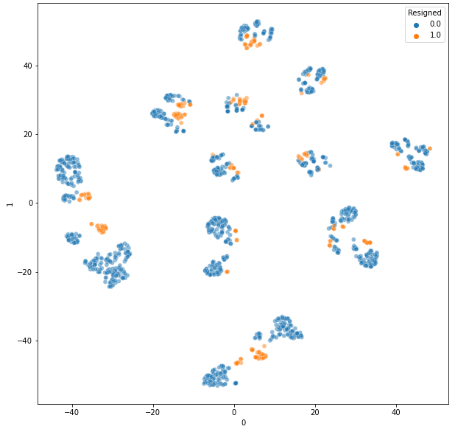
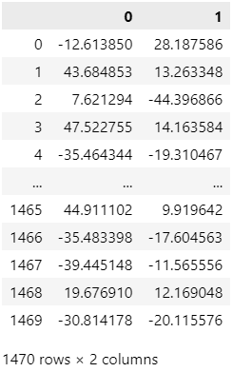
· t-SNE Gower Distance ·
By plotting the t-SNE formed from the gower distance df, we can see that there is after using t-SNE on the Gower Distance data there are multiple different clusters that has been formed. This seems to
be a fairly robust solution with
the Resign forming clusters.
We will be using this dataset
for the clustering models as
the cluster points are quite
clear

Slide 30
· Clustering ·
After we are done preparing the data and testing for clustering tendency, we will proceed to perform some clustering with some of the most commonly used clustering algorithms.
We will be using the following clustering algorithms:
1. K-Means Clustering (Centroid-based)
2. Agglomerative Clustering (Hierarchical-based)
3. Spectral Clustering (Distribution-based)
4. DBScan Clustering (Density-based)

Slide 31
· K Means Clustering ·
K Means clustering is a simple and popular algorithm for clustering data. It is a simple algorithm that follows an iterative approach which attempts to partition the dataset into different "K" number of predefined and non-overlapping clusters.
Choosing Number of k
We will be using 2 approach to evaluate the quality of clusters with K Means of different k values.
Elbow Method using Inertia
Silhouette Analysis

Slide 32
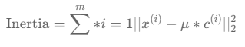
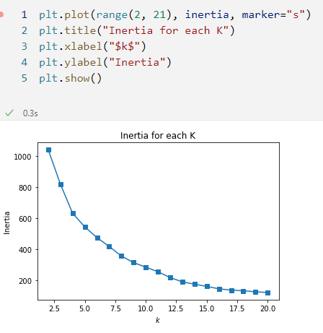
· Elbow Method using Inertia ·
Inertia is the sum of squared distance of samples to their closest cluster center. We would like this number to be as small as possible. But, if we choose K that is equal to the number of samples we will get inertia=0.
Observations
As expected, as k increases the inertia value will decrease
while picking the k value we need to consider the trade off
as after a certain point, the improvement in the inertia
value is not significant.
In this case, there is no clear k value to be chosen as there
is no clear elbow

Slide 33
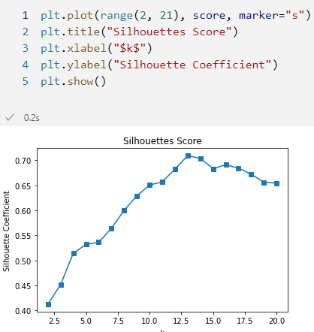
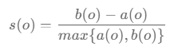
· Silhouette Analysis ·
Silhouette analysis can be used to study the separation distance between the resulting clusters. The silhouette plot displays a measure of how close each point in one cluster is to points in the neighbouring clusters and thus provides a way to assess parameters like number of clusters visually. This measure has a range of [-1, 1].
Observations
Through the analysis of Silhouette score max out at k = 13
Hence, k = 13 might be a good candidate for the number of clusters generated, we will be performing a more comprehensive Silhouette Analysis.
A potential range of k could be 11 - 15

Slide 34
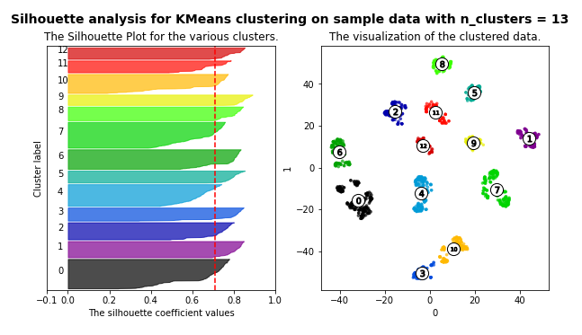
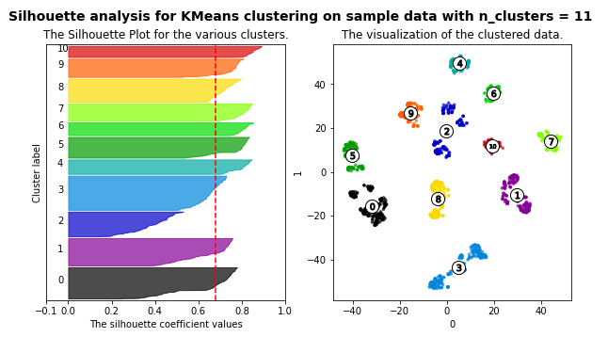
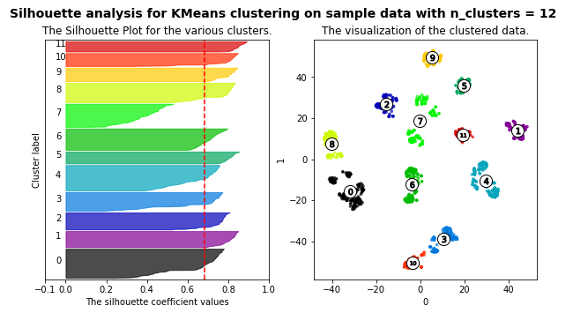
· Silhouette Analysis ·
The best average silhouette score is 0.7092220187187195 belonging to n_clusters = 13.
Most silhouette have cluster label coefficient values is more than the average silhouette indicated using the red line.
n_clusters that have cluster label coefficient values below the red line are [9,10,11,12]
Another factor to consider if n_clusters should be used is the distribution of the cluster. If distribution is the same then it shows that the the clusters are in the same size. To find the distribution of the cluster we will be comparing the width of the cluster label.
n_clusters that does not have the same width
are [2,5,6,7,8,11,14,15]
Clusters that are valid = [1,3,4,13]

Slide 35
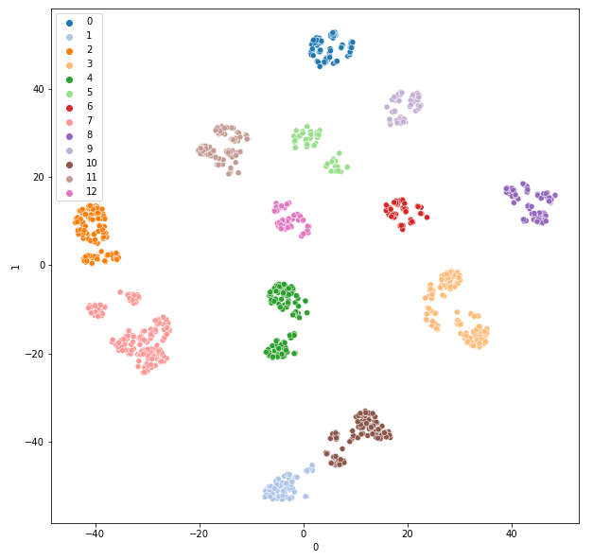
· K Means (n_cluster = 13) ·
The best average silhouette score is 0.7092220187187195 belonging to n_clusters = 13.
We can see that K Means 13 forms clear clusters and there are no overlaps of clusters which makes it a strong possible cluster

Slide 36
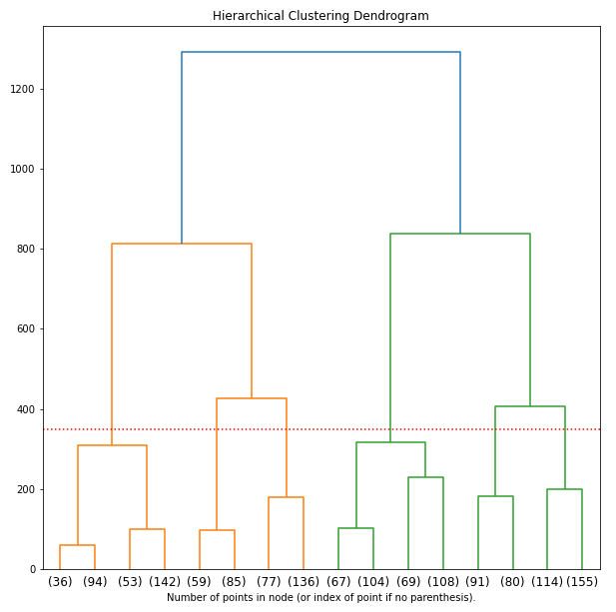
· Agglomerative Clustering ·
Agglomerative Clustering is a type of hierarchical clustering algorithm. It is an unsupervised machine learning technique that divides the population into several clusters such that data points in the same cluster are more similar and data points in different clusters are dissimilar.
Observations
It seems that the points in the node (102)(168) and (162)(529) is very different due to the large difference in the dendrogram. The taller the edge the bigger the difference, the closeness of the data points are given by the vertical position of the split.
From the dendrogram generated, the reasonable number of cluster that would be k = 6 as we look at all the vertical lines. The vertical lines with the maximum distance is the green line and hence we can decide a k = 6 to cut the dendrogram

Slide 37
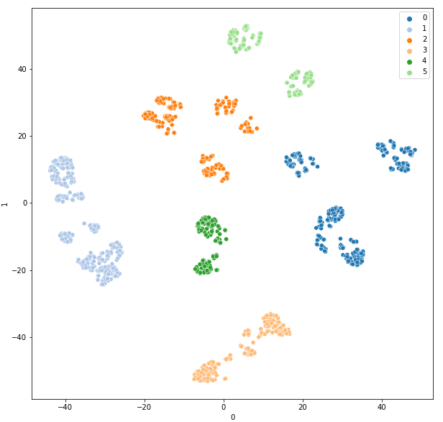
· Agglomerative Clustering ·
Silhouette Score: 0.5364595
Observations
By comparing the clusters formed using Agglomerative Clustering, we notice that none of the clusters overlap which is a good thing as there is no ambiguity.
We also note that the Agglomerative Clustering looks similar to the KMeans Cluster (n_clusters=6). This is also further proven as the silhouette score for KMeans (n_cluster=6) and Agglomerative Clustering (n_cluster=6) is the same at 0.5364595

Slide 38
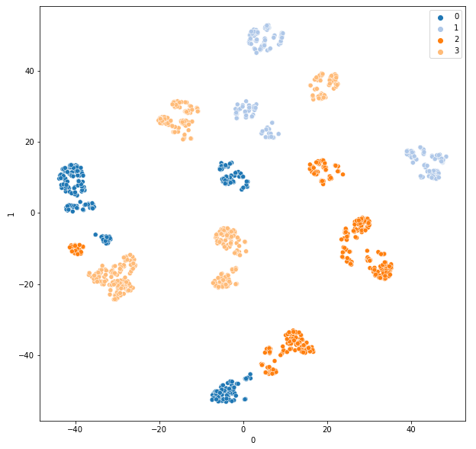
· Spectral Clustering ·
Spectral clustering is a technique with roots in graph theory, where the approach is used to identify communities of nodes in a graph based on the edges connecting them. The method is flexible and allows us to cluster non graph data as well. Spectral clustering uses information from the eigenvalues (spectrum) of special matrices built from the graph or the data set. We’ll learn how to construct these matrices, interpret their spectrum, and use the eigenvectors to assign our data to clusters. We will be using n_clusters of 4 as it is one of the clusters in KMeans which is valid.
Silhouette Score: 0.13540813
The clustering of SpectralClustering has clusters in different points of the scatter plot. There are no overlaps in the clusters which means that the clusters are no ambiguous.
However, the silhouette score states that the mean clusters are indifferent or the distances between the clusters are not significant

Slide 39
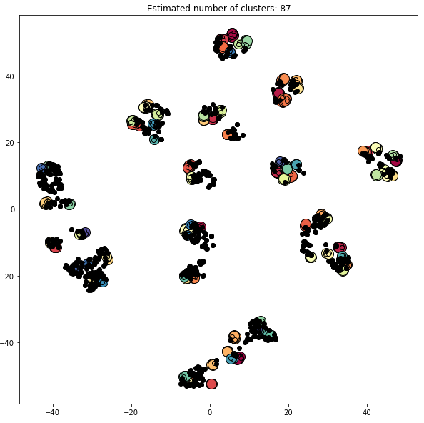
· DBSCAN ·
Density-based spatial clustering of applications with noise also known as DBSCAn is a data clustering algorithm. DBSCAN Groups points together that are close by based on a distance measurement usually Euclidean distance and a minimum point. It also marks outliers as points that are in low density regions. DBSCAN will require hyperparameter tuning as epsilon and min point to find the optimal value. But first we will be using DBSCAN's default params of epsilon = 0.5 and min point = 5
Silhouette Coefficient: -0.203
Using the silhouette score, the coefficient is -0.203 which means that the clusters are assigned in the wrong way. This is bad and we will need to change and increase the models parameters. But let us see what is wrong with the clustering.
The estimated number of clusters is 87 which means that the epsilon value might be too small for the data to form meaningful clusters. We note that the min point value is making those dots that are black considered outliers and might need to be adjusted to make the clusters more meaningful

Slide 40
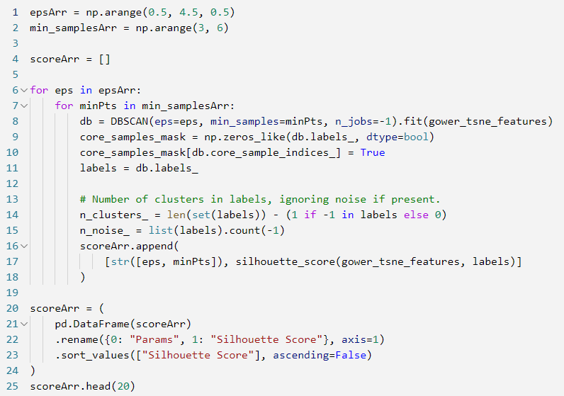
· DBSCAN Hyperparameter Tuning ·
We will be using custom made GridSearchCV to run through the parameters to see which model's parameter will give the best silhouette score.
Parameters that we will be tuning for the DBSCAN:
eps - Maximum distance between 2 samples for one to be considered as a neighbouring point
min_samples - Minimum number of points around the sample to be considered as a neighbouring point

Slide 41
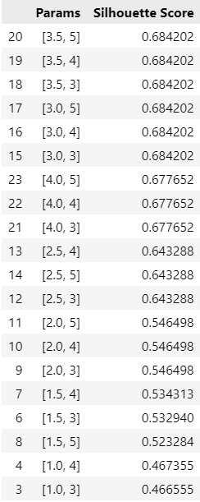
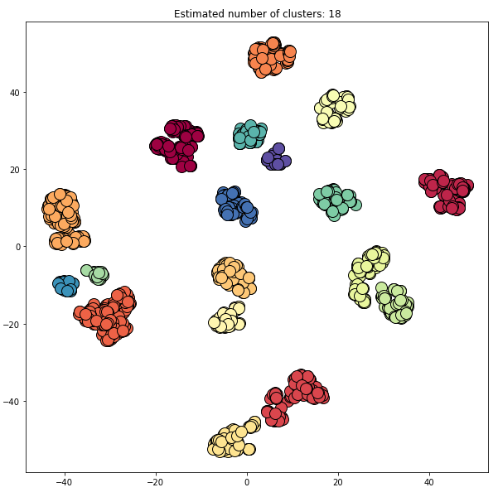
· DBSCAN Hyperparameter Tuning ·
The silhouette score has a max peak which is 0.684202. As such eps = 3 and minPts = 3 will be the capping distance params that we will be using to do clustering. We can also use the eps = 4 and minPts = 4 as the silhouette score is the 2 best score.
We observe that DBSCAN is able to form clusters with it's neighbouring points and the clusters are not overlapping each other (DBSCAN will just form it together as a cluster).
There are also 18 different clusters that are formed, even small clusters that KMeans and other models are unable to cluster together are formed.

Slide 42
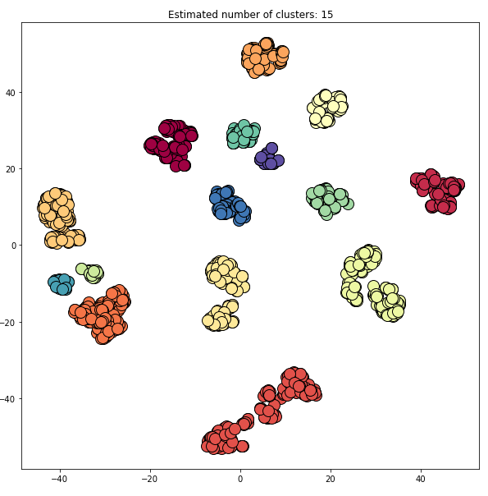
· DBSCAN Hyperparameter Tuning ·
Silhouette Score: 0.678
We will be using eps = 4 and minPts = 4 as it gives 15 different clusters instead of 18 like eps = 3 and minPts = 3 which makes interpreting the clusters easier.
Model Selection
After looking at the different clusters formed, the models that are generally useful is K Means and DBSCAN as Agglomerative Clustering is the same as KMeans n_clusters = 6 where the distribution based of the silhouette plot is not evenly distributed and Spectral Clustering have a low silhouette score which means that the mean of the clusters are indifferent or the distance between the clusters are insignificant because Spectral Clustering caused clusters to be in many different places in the scatter plot.However, between DBSCAN and K Means there is no clear distinguishing factor to differentiate the values and thus we will be see which provides a better cluster interpretation.

Slide 43
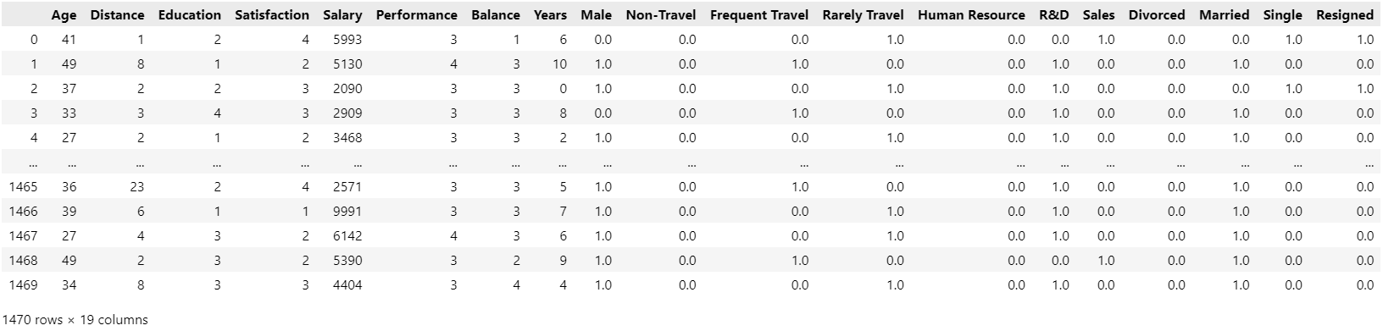
· Cluster Interpretation ·
We will first do a bit of renaming of the columns of the dataframe to make our lives of interpreting the columns easier.

Slide 44
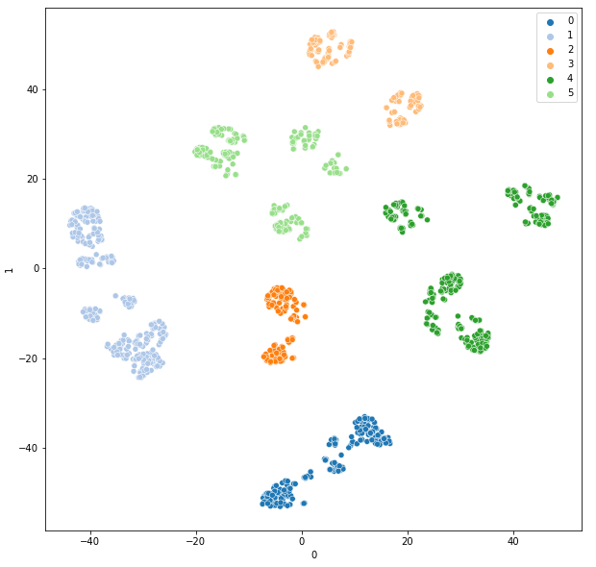
· Cluster Interpretation - K Means ·
We will be using K Means (n_clusters=6) as we want to reduce the number of clusters that we have that needs to be interpreted.

Slide 45
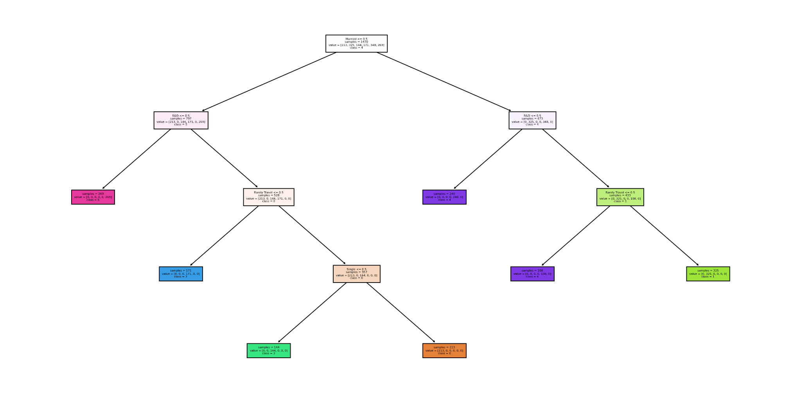
· Surrogate Model - K Means ·
To better quantify the clustering rule, a Decision Tree can be used as a surrogate model for us to better understand the decision rule by which each cluster is associated.
Features that are important:
Married - T or F
R&D - T or F
Rarely Travel - T or F
Single - T or F

Slide 46
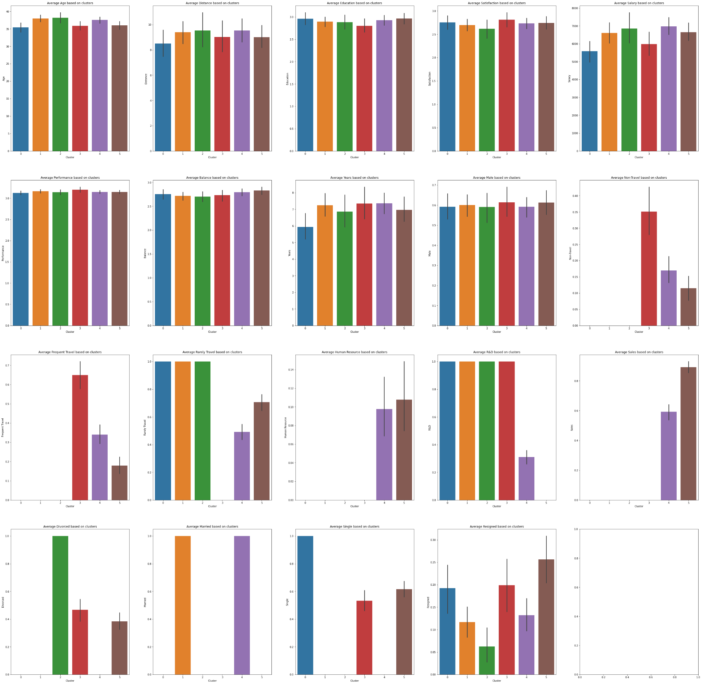
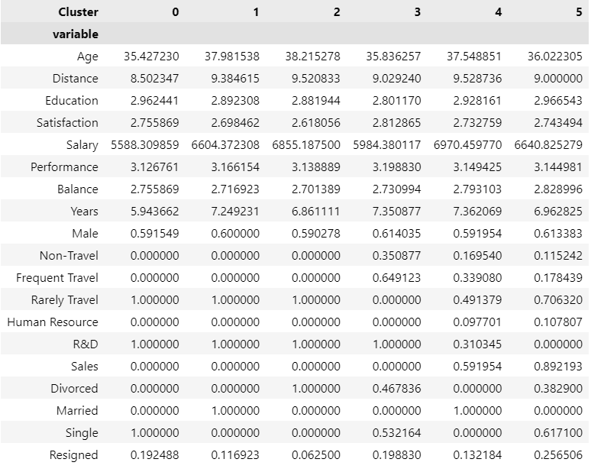
· Cluster Visualisation - K Means ·
We will split the clusters and see the relationship with the variables. For ease of reading the bar group we will make a dataframe that sums up all the
information.

Slide 47
· Cluster Interpretation - K Means ·
Cluster 0: Young Single R&D Employees
Single R&D Employees that Rarely Travel and is aged around 35 and joined the company for around 5 years are likely to quit the job. This might but likely due to them being younger and wants to explore their own love life and form families before they hit their 40s.
Cluster 1: Middle Aged Married R&D Employees
Married R&D Employees that rarely travels and age is close to 40. They have stayed in the company for 7 years. These employees are unlikely to quit as they have a family and is settling down as a middle man.
Cluster 2: Rich Middle Aged Divorced R&D Employees
Divorced R&D Employees that rarely travels and age is close to 40. They have also say in the company for 7 years and earn approximately $6900. These employees are unlikely to quit as they have lost their partner and would want to focus on their work instead of their love life as they are too old for it and earn a lot of money.

Slide 48
· Cluster Interpretation - K Means ·
Cluster 3: Male R&D Employees climbing corporate ladder
Majority of the Male R&D Employees that majority travel frequently and are single or divorce are not ready to quit as they are young (aged around 35) are unlikely to Resign as they want to climb the corporate ladder and focus on their own personal life like travel frequently.
Cluster 4: Rich Married Employees
Married Employees that earns around $6900 and stays 9.5 km away from the company like to maintain at their job. This is likely due to the fact that they earn the most in the company and have a family to feed.
Cluster 5: Single Male Sales Employee
Majority of Single, Male and from the Sales department that rarely travels and live 9 km away from the company are likely to quit as they are quite young and want to work on their love life and work on their own self

Slide 49
· Cluster Interpretation - DBSCAN ·
We will be using DBSCAN (eps=4, minPts=4) as mentioned previously this is better than (eps=3, minPts=3) as the number of clusters is lower.
Silhouette Score: 0.67765224

Slide 50
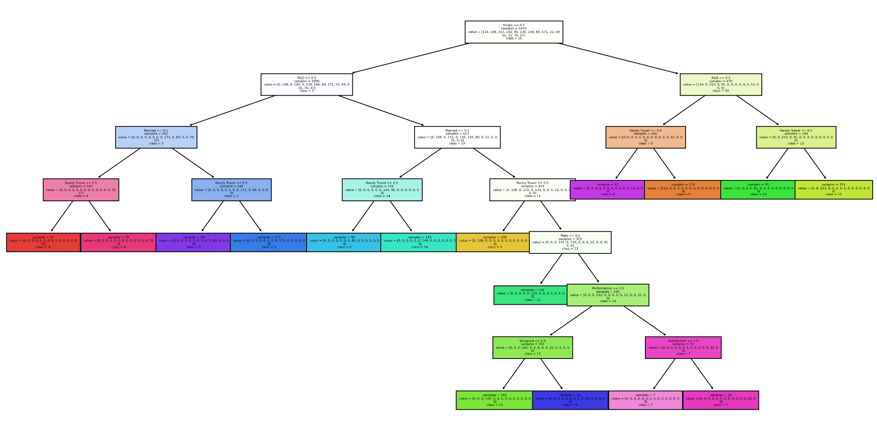
· Surrogate Model - DBSCAN ·
To better quantify the clustering rule, a Decision Tree can be used as a surrogate model for us to better understand the decision rule by which each cluster is associated.
Features that are important:
Single - T or F
R&D - T or F
Married - T or F
Rarely Travel - T or F
Male - T or F
Performance - <=3.5
Satisfaction - <=1.5

Slide 51
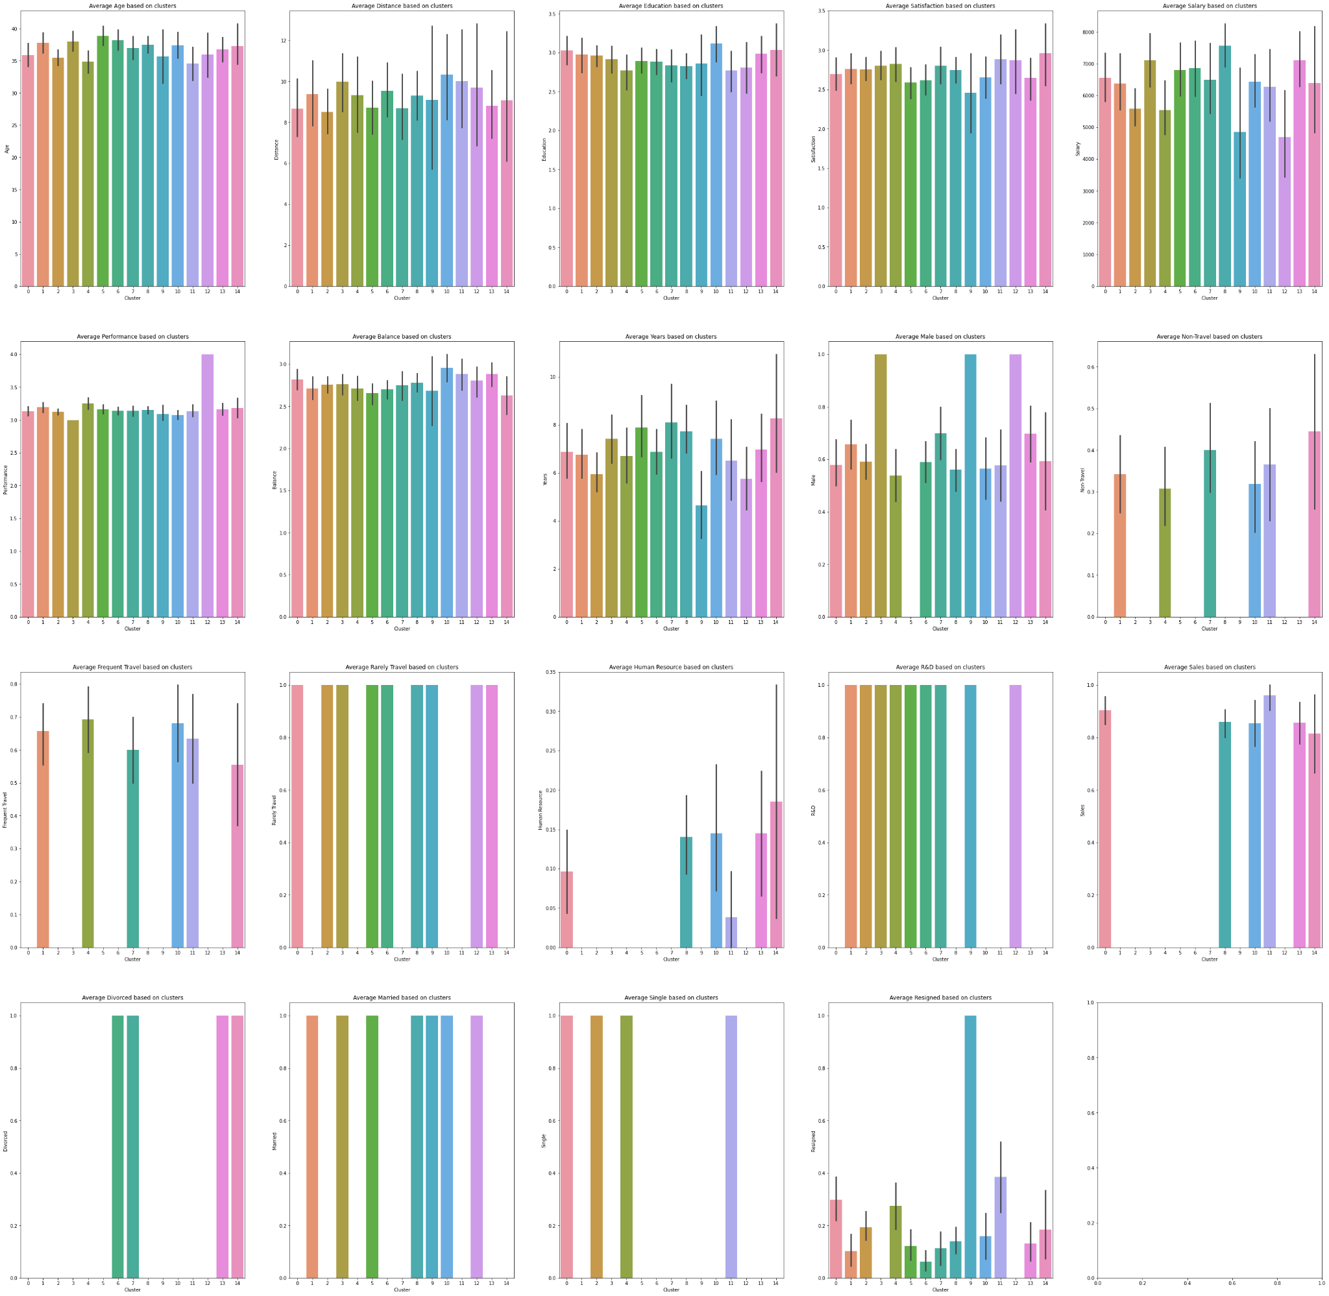
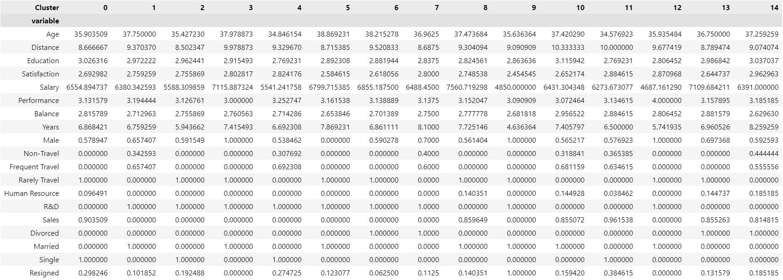
· Cluster Visualisation - DBSCAN ·
We will split the clusters and see the relationship with the variables. For ease of reading the bar group we will make a dataframe that sums up all the
information.

Slide 52
· Cluster Interpretation - DBSCAN ·
Cluster 0: Young Single Sales Employee that are unsatisfied with the job
Single Rarely Travel Sales employee that are young (<= 35) are likely to quit due to the need to them wanting to make use of their education to do something outside of Sales. Furthermore, they are also not satisfied with the job too.
Cluster 1: Rich Married Male R&D that frequently travel
Married Male R&D that frequently travel that earns more than $6300 are likely to stay in the company as they earn a lot of money. They are unlikely to quit as they have a family to feed.
Cluster 2: Young Single R&D Male that want to climb corporate ladder in a different company
Single R&D Males would likely quit the company as they are young and want to earn more money as they are only paid $5500.
Cluster 3: Rich Married Male R&D Employee
Married Male R&D with high salary that rarely travel stays and are 100% committed to the company because they have a family and is paid enough.

Slide 53
· Cluster Interpretation - DBSCAN ·
Cluster 4: Young Single R&D Employees that earn very little and have low education
Single R&D that Frequently Travel aged around 34 are likely to leave the company as their salary are very low at around $5500 and get more job opportunity outside of the company. Furthermore, they want to work on themselves as their education is low compared to the others and potentially get married.
Cluster 5: Rich Married Middle Aged R&D Female that performs very well
Middle aged (40) R&D Females that rarely travel are unlikely to quit as their performance are very good and are paid around $6800. They are also married and have a family to feed.
Cluster 6: Rich Divorced Middle Aged R&D Employee
Divorced Middle Aged R&D Employee that rarely travel are unwilling to quit as they earn $6900 and is too old to work on their love life.
Cluster 7: Rich Divorced R&D Employee strong performance
Divorced R&D mostly male employee are unlikely to quit the company as they earn $6500 and have strong performance. Not only that, but also they have worked there for 8 years and climbed the corporate ladder which means quitting would render their hard work useless.

Slide 54
· Cluster Interpretation - DBSCAN ·
Cluster 8: Rich Married Middle Aged Sales employee
Married Middle Aged Sales employee who earns $7500 is unlikely to quit as they earn so much money and have a family to feed.
Cluster 9: Young Married R&D Male employee that earn less than $5000 and does not perform well and no work life balance
Young Married R&D Male employee that rarely travel and earn less than $5000 are 100% going to resign as they are starting their own families and supporting a family need more money. Furthermore, they are not performing well and could be let go by the company and they felt that there is no work life balance.
Cluster 10: Rich Married Middle Aged Sales employee that love the work life balance
Married and mostly in the sales department employee that frequently travel are unlikely to leave the company as they enjoy living a balanced lifestyle and earns $6400.

Slide 55
· Cluster Interpretation - DBSCAN ·
Cluster 11: Young Single Sales employee that stay far away from the company
Young Single Sales employee under the age of 35 are likely to quit the company as they live 10 km away from the company making travel time a factor. They are also young and want to make time for themselves as they frequently travel.
Cluster 12: Married R&D employee that performs very well
These employees are 100% committed to the company as they perform very well at their own job which means that they enjoy the job despite the bad pay.
Cluster 13: Rich Divorced Young Sales employee
These employees are unlikely to quit the job as they are paid $7000 and even though they are divorced, they want to help earn money before going back into the dating game.
Cluster 14: Divorced Middle Aged Sales employee no work life balanced
These employees have worked for 8 over years in the company and earn $6000. They are likely to quit the job because they find it hard to balance their work and life.

Slide 56
· Summary ·
As DBSCAN's Clusters give us the most insights in the different clusters, we will be using the DBSCAN data to help and give recommendation to the company.
First, the companies should look out for the following cluster of people
Cluster 0: Young Single Sales employees that are unsatisfied with the job (Bored of Sales)
Cluster 2: Young Single R&D Male that want to climb the corporate ladder at a different company (Paid too little)
Cluster 4: Young Single R&D employee that have very little education and pay (Paid too little and not enough education)
Cluster 9: Young Married R&D Male employee that earn less than $5000 and does not perform well and have no work life balance (no work life balance)
Cluster 11: Young Single Sales employee stay far away from the company (stay too far)
Cluster 14: Divorced Middle Aged Sales employee with no work life balance (no work life balance)
Generally, based on this cluster we can see that the people under 35 are a problem as they do not have a goal in life yet. Pay is also a problem where employees feel that they are undervalued in the company. The company can also give them a more balanced work life by giving them more breaks and allow employees to take leaves.

Slide 57
· Recommendations ·
Management could increase the salary above the average salary or offer excellent benefits like family bonus etc.
- It will lock employees in and encourage them to stick around for the pay and perks
Management can provide external learning opportunities like SkillsFuture to make them upskill themselves so that they do not worry able not having sufficient experience
providing them the opportunity to upskill will make the company more profitable in the long run too
Management can give more breaks and allow employees to take more leaves
Employees like how flexible it is to work and will start to enjoy work as a whole
Management can host workshops and seminars for the employees to encourage and form their dreams and allow them to speak up for themselves
This will make employees feel more comfortable and make them feel like work is like home

